Slide 1






KONGU ENGINEERING COLLEGE
PERUNDURAI ERODE-638060
DEPARTMENT NAME
KEC IDEATHON
IOT-ENABLED POWER SAVING
SYSTEM FOR SMART HOMES
Team Lead: HARI HARAN.V(20ECR049)
Team Members:
KARTEESWAR.K.P( 20ECR071)
GOKUL.D( 2ECL213)
Technology Readiness Level:
TRL –TECHNOLOGY CONCEPT FORMULATED
Team Mentor with Designation and Department:
Mr.R.P.Karthik
Assistant professor-ECE DEPT
In association with:

Slide 2


The Problem
In our life we are using different kind of appliances like television ,fan , air cooler etc. ,because of that the consumption of electricity is drastically high in last 10 to 15yrs, also the cost electricity getting high comparted to previous years, So we focus on the additional usages like ,when human mentally or physically getting absence like (sleeping ,left apart….etc.). To recover that problem.

Slide 3
The Solution
When the user switch ON the Television at same time ,the PIR sensor also gets activated, if suppose no presence of human for while ,both the TV and the sensor tends to sleep.
When PIR sensor the detected presence of human and the Camera also gets ON.
If suppose the user slept or there is no motion of user for some time.
It convey the scanned information to cloud using the image processing.
And it alter the Television ,depends on user comfort (Egg: television tends to sleep or gets power off).

Slide 4
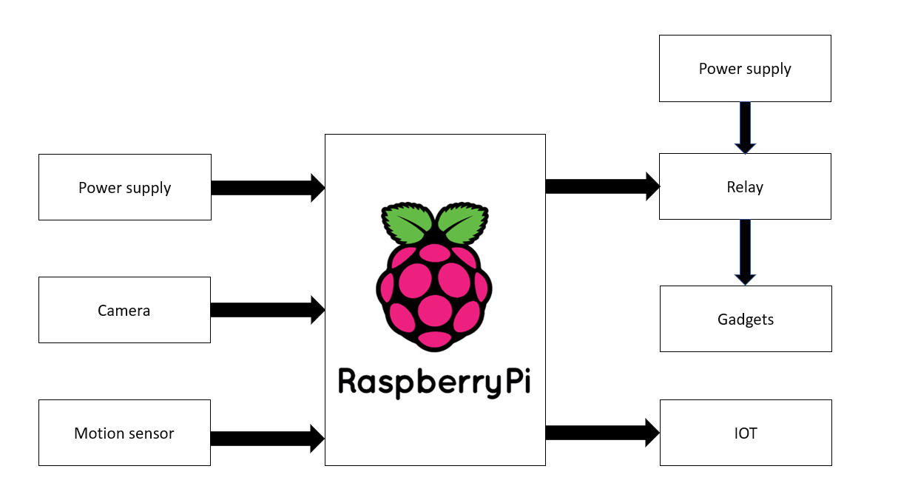
Flowchart / Product workflow

Slide 5
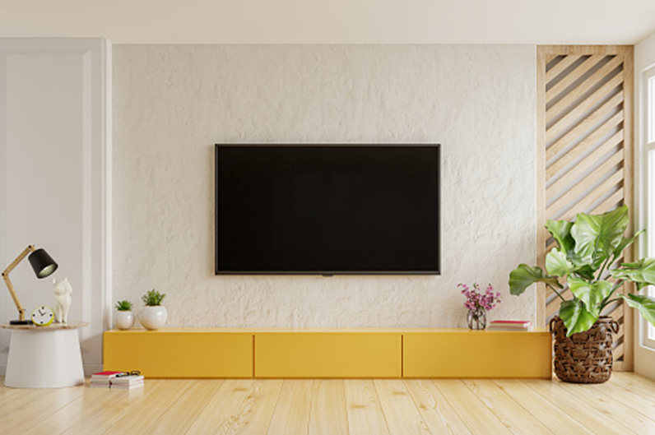

Model Design:

Slide 6
Competitors
Now a days smart TV inbuild with a sleeper mode on manullay for only fixed time.
But in our project automized by using camera for controlling the television by detecting the presence of user.
More than other projects we have more advantages.
Also amount was comparably low.
One time investment. Also an user friendly.

Slide 7
Uniqueness / IP & Value Proposition
It was an one time investment , it also good for longer period of time.
Of course we really happy on introducing this project with public.
Compared to other competitors we are offering in very low cost .
For an one home may be looks it saves like less amount of power but it benefits for life long one.
Just think it for hole world.

Slide 8
Idea - Current Status / Future Plan Timeline & Milestones
Till now we are just implemented on television ,as soon as we are in the plan implement on (fan or air cooler) depends on temp level, latterly make entire home on automation.
Also focusing on Automation with good standard security.
Efficiency increased as well as cost reduced.
Portable and reduced model.
Also try to implement in all personal and professional spaces .

Slide 9
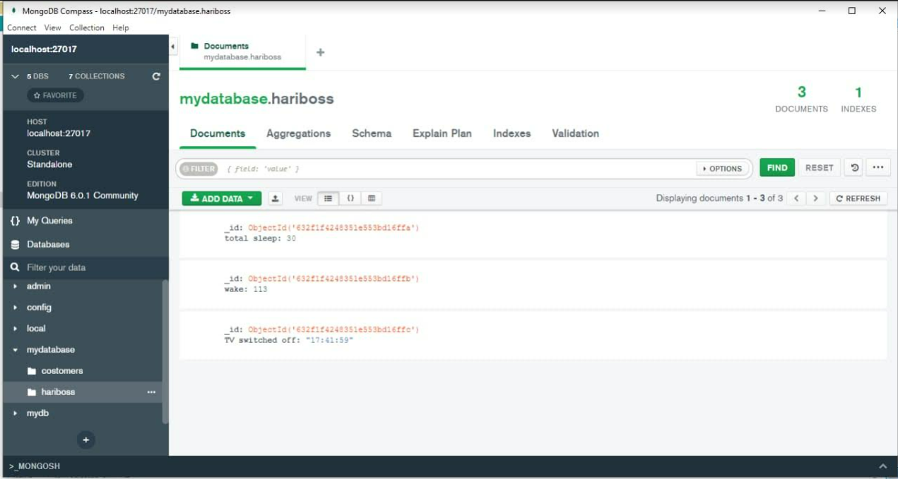
The data is obtained from the MongoDB database.

Slide 10
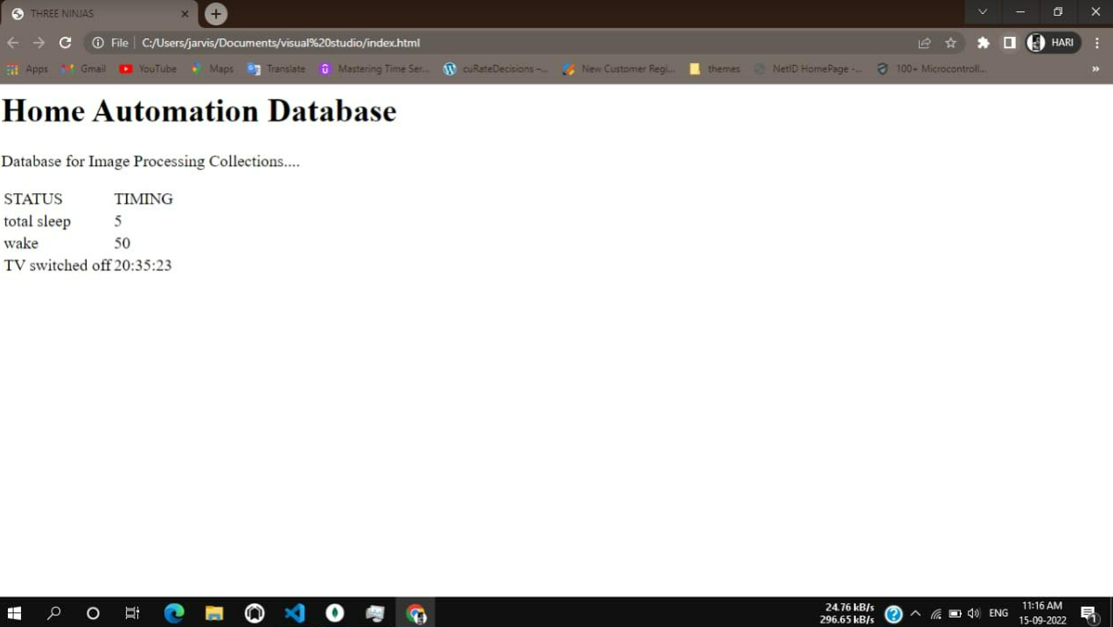
Database:

Slide 11
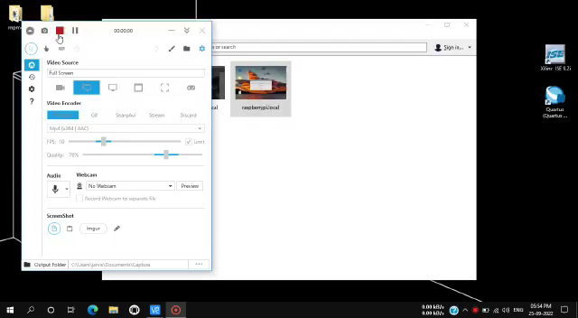

Slide 12
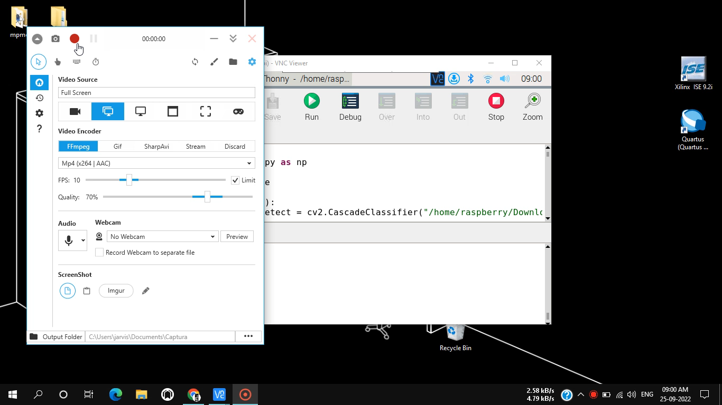

Slide 14
Thank You !!

